Slide 1
Introduction
Cash Flow Diagrams

Slide 2
Cash Flows
To financially analyze projects, we need to model the projects in terms of cash flows
Cash flows represent the flow or movement of money at some specific time over some period of time
Outflows represent cash that is leaving an account such as a withdrawal (expenses or disbursements or losses or costs)
Inflows represent cash that is entering an account such as a deposit (revenues or receipts or benefits or incomes)

Slide 3
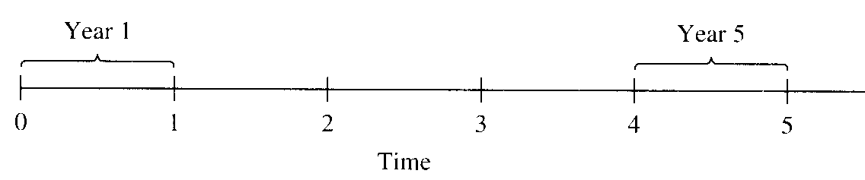
Cash Flows and Engineering Projects
An engineering project can be viewed as an account with outflows and inflows
Cash flow movements can be visually displayed through the use of a cash flow diagram

Slide 4
Cash Flow Diagram
A cash flow diagram is a picture of a financial problem that shows all cash inflows and outflows plotted along a horizontal time line
The cash flows over time are represented by arrows at relevant periods: upward arrows denote positive flows and downward arrows denote negative flows
Arrows represent net cash flows since two or more values at the same time are summed and shown as a single arrow
Net cash flows = receipts – disbursement
= cash inflows – cash outflows

Slide 5
Cash Flow Diagram
Generally, the start of the diagram represents the beginning of the interest period
When t = 0, this is the present
When t = 1, this is the end of the first year (or beginning of the second year)
A typical cash flow time scale for 5 years

Slide 6
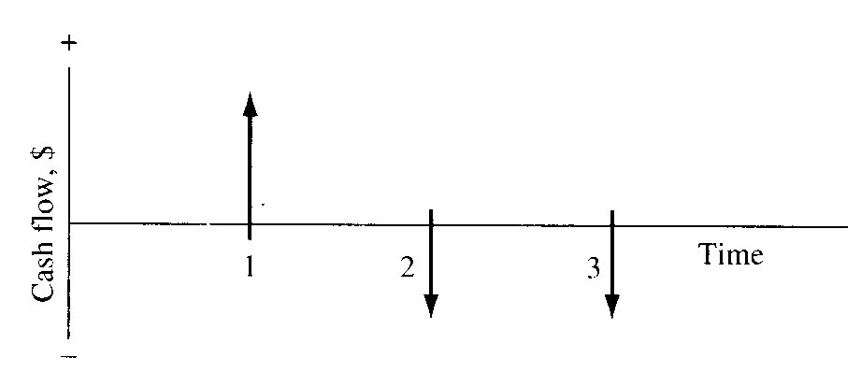
Cash Flow Diagram
The figure illustrates a receipt (cash inflow) at the end of year 1 and equal disbursements (cash outflows) at the end of years 2 and 3
Example of positive and negative cash flows

Slide 7
Cash Flow Diagram – Example [1]
You borrowed $1,000 from a bank to purchase a laptop. The bank requires you to make 12 equal monthly payments of $95 to pay off the loan
Draw the cash flow diagram for this scenario
$1,000
1 2 3 4 5 6 7 8 9 10 11 12
$95 $95 $95 $95 $95 $95 $95 $95 $95 $95 $95 $95

Slide 8
Cash Flow Diagram – Example [2]
A company spent $2,500 on a new compressor 7 years ago
The annual income from the compressor has been $750
Additionally, the $100 spent on maintenance during the first year has increased each year by $25
The company plans to sell the compressor at the end of next year for $150
Construct the cash flow diagram from the company’s perspective

Slide 9
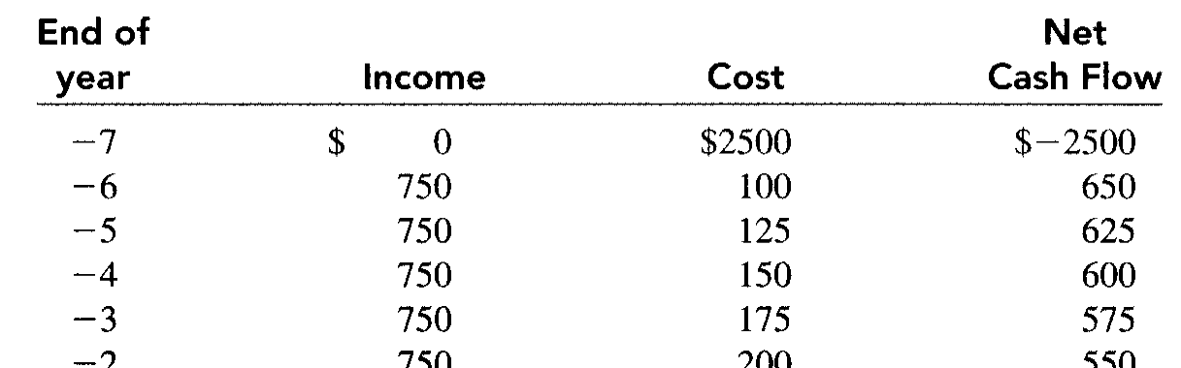
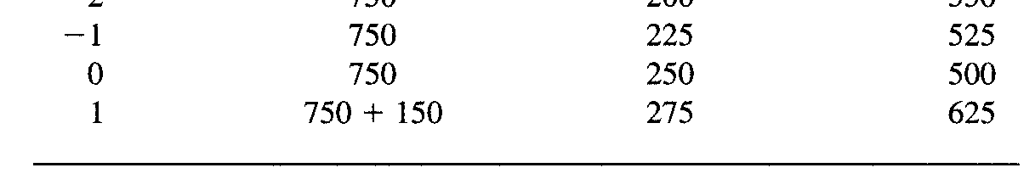
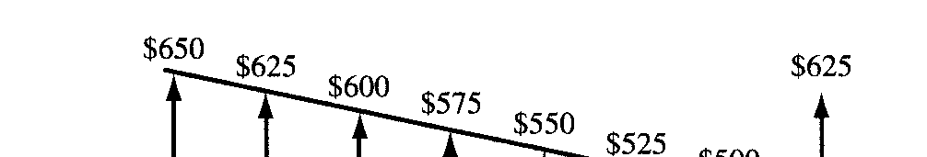
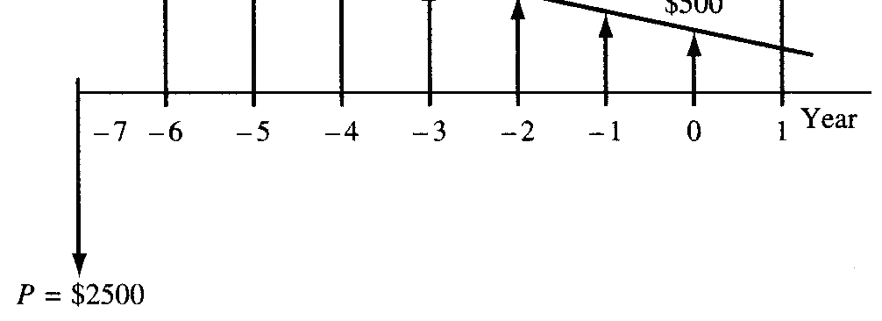
Cash Flow Diagram – Example [2]
Use now as time t = 0
The incomes and costs for years -7 through 1 (next year) are tabulated

Slide 10
Cash Flow Diagram – Example [3]
A company expanded its operations with the purchase of a
$10 million rolling mill in 2004
Assume that the new mill runs at peak capacity (4.375 million pounds of output per year) for 10 years
Assume that a pound of output generates $9 in revenues while costing $3.90 to produce
Maintenance of the equipment is $10 million the first year and grows by $1 million per year
Finally, the mill is to be scrapped at the end of 10 years for
$500,000
10

Slide 11
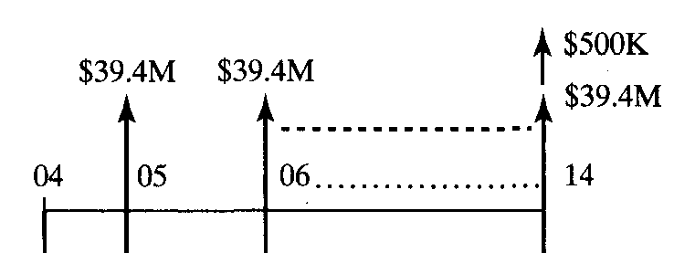
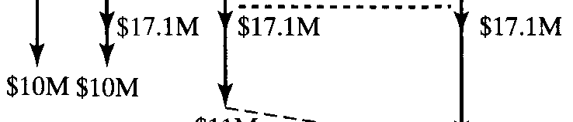
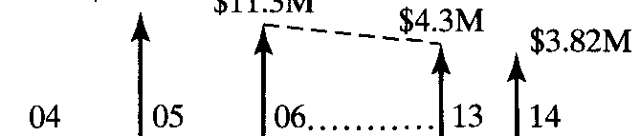
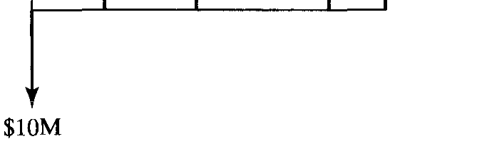
Cash Flow Diagram – Example [3]

Slide 12
Cash Flow Diagram – Example [4]
You deposited a $1,000 in your account in a bank that gives a daily interest of 0.003% where interest is paid monthly. Assume simple interest
[1] For this scenario, what is your balance after 30 days?
[2] If you deposit another $2,000 on the 11th day and withdraw $500 on the 26th day, what is your balance at the end of the 30th day?
In both cases, draw the cash flow diagram

Slide 13
Cash Flow Diagram – Example [4]
[1] Since we have simple interest, then F = P(1+ni)
 F = $1,000×(1+30×0.003%) = $1,000.9
F = ?
P = $1,000

Slide 14
Cash Flow Diagram – Example [4]
 [2] F = $1,000×(1+30×0.003%) +
$2,000×(1+20×0.003%) –
$500×(1+5×0.003%) = $2,502.03
$500
F = ?
$1,000 $2,000
Just keep in mind that the day is represented by its beginning

Slide 15
Cash Flow Diagram – Example [5]
You have deposited $1,000 with an interest rate of 3% every 6 months where the interest is computed every 6 months
How much you will have after 5 years?
Two years later after the initial deposit of the money, you deposited additional $1,000 with an interest rate of 2% every 6 months. How much will you have after 5 years?

Slide 16
Cash Flow Diagram – Example [5]
We have a total of 10 periods each period of 6 months for the $1,000
 F1 = P(1+i)^{n} = $1,000×(1+3%)¹⁰ = $1,343.92
n = 10 and i = 3%
F₁?
$1,000

Slide 17
Cash Flow Diagram – Example [5]
We have a total of 10 periods each period of 6 months for the first $1,000 [F1]
We have a total of 6 periods each period of 6 months for the second $1,000 [F2]
 F = F1+F2 = $1,000×(1+3%)¹⁰ + $1,000×(1+2%)⁶ =
$2,470.08
n = 6 and i = 2%
F?
$1,000
$1,000

